Slide 1

Credit Card Fraud Identification
Nathan Soer
DSC 630

Slide 2
Agenda
Problem Statement
Data Description
Ethical Concerns
Data Exploration
Predictive Models
Results
Conclusion

Slide 3
Problem Statement
Consumer credit card fraud is an increasing problem for many businesses and consumers. Early detection is essential in reducing fraud.
2024 FTC Fraud statics
Losses increased to $12.5 Billion^{[1]}
Estimated 62 million impacted individuals^{[2]}

Slide 4
Data description
Data was gathered from European consumers in 2023
550,000 individual transactions
This data set was specifically created for developing fraudulent transactions
28 data points were gathered in addition to the amount of the transaction
Data gathered includes attributes like time, location, merchant, etc.
These data points were anonymized to remove identifying information

Slide 5
Ethical concerns
Financial information like credit card transactions require special handling to avoid ethical issues
Personally Identifiable Information should be anonymized to help prevent identity theft
The method of anonymization imposes risks of skewing the data

Slide 6
Data Exploration
29 features are in the data set
Several features are highly correlated

Slide 7
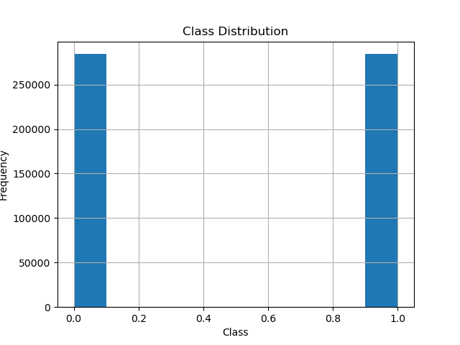
Data Exploration
Class 0 indicates normal transaction
Class 1 indicates fraudulent transaction
The roughly even split between the two types suggests the data was curated

Slide 8
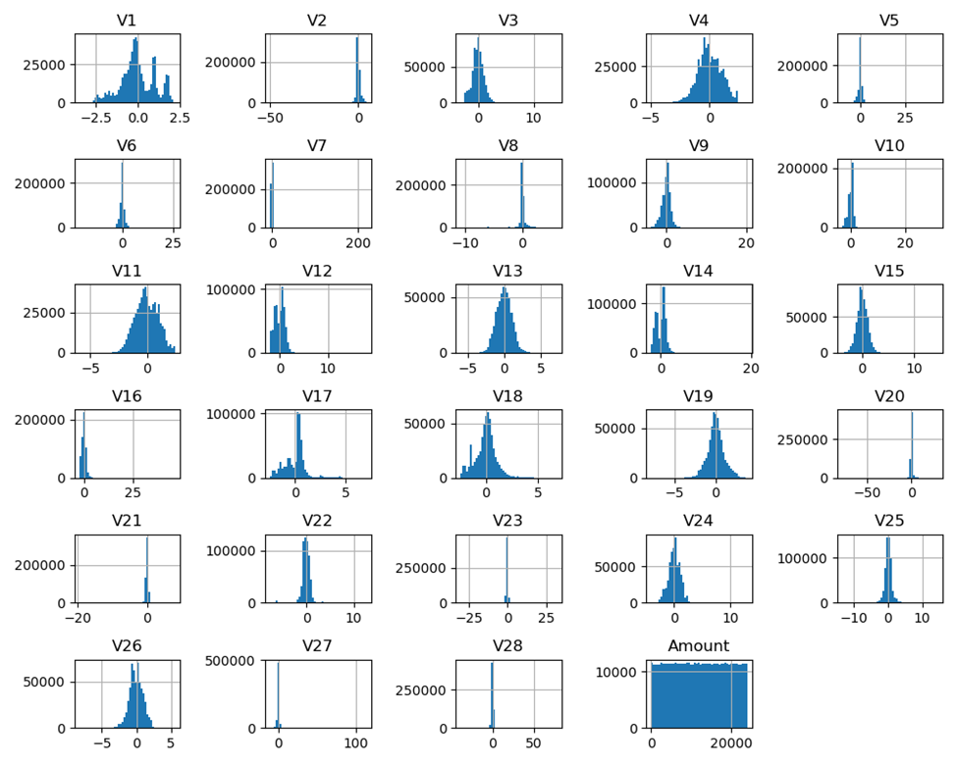
Data Exploration
Several features are highly skewed
Features V1 is multi modal

Slide 9
Predictive Models
Models:
Logistic Regression
Decision Tree
Random Forest
K-Nearest Neighbor
Metrics:
Accuracy
F1-Score
Precision
Recall

Slide 10
Results
Model | Metrics
 | Accuracy | Precision | Recall | F1-Score | Time
Logistic Regression | Model did not converge
Decision Tree | 99.09% | 99.09% | 99.09% | 99.09% | 00:08.92
Random Forest | 99.82% | 99.82% | 99.82% | 99.82% | 2:32
K-Nearest Neighbors | 90.23% | 91.00% | 90.24% | 90.19% | 00:10.7
Random Forest was the best at predicting fraudulent transactions
Decision Tree was slightly worse at predicting fraudulent transactions
K-Nearest Neighbors was the worst at predicting fraudulent transactions

Slide 11
Conclusions
Random Forest is recommended for accuracy, however it is the slowest of the models
Decision Tree is recommended for applications that require speed, it does have the cost of some accuracy
Additional work will need to be done before the model is ready for deployment

